Slide 1
Business decisions and role of data in business decision making
Presented by:
Group: Neha, Geryl, Nafisat, Abid,
Case study on Lube Distribution:
Reference:
Business Intelligence System for Operational Decision Making Support: A Case Study on Lube Distribution
Mashudi, Nur Rachmawati, Tri Suranto, Irva Dwinovita CSS Division, HR and General Affair Department PT Pertamina (Persero) Jakarta, Indonesia

Slide 2
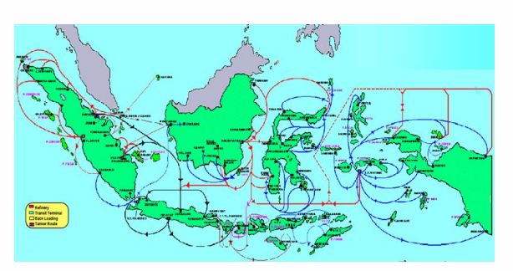
Pertamina History and Geographical Presence
PT Pertamina Lubricants is a leader in Lubrication business in Indonesia and growing very rapidly.
Three factories
Forty Depots
Presence in seven sales regions
Nine hundred sales agents
Notes:
Geryl:
As the market leader of lubricants in Indonesia, PT Pertamina Lubricants apprehends that the market competition of lubricants industry in Indonesia never been the same since
the liberalization of lube oil sector in 2001. The growing number of lubricant producers from local and foreign business has driven the industry competition up to the next level. In
order to preserve its position in the local market and expand the business to global market, PT Pertamina Lubricants has to improve the capability of developing and executing proper
business strategic, making effective and efficient business

Slide 3
Pertamina Problem Statement
PT Pertamina Lubricants has to improve business decision making process
How to utilize available information system effectively
Over the number of years ERP system adoption have grown into large data pool
How to compete with local and international competitors
Reference:
Business Intelligence System for Operational Decision Making Support: A Case Study on Lube Distribution
Mashudi, Nur Rachmawati, Tri Suranto, !rva Dwinovita CSS Division, HR and General Affair Department PT Pertamina (Persero) Jakarta, Indonesia
Notes:
Abid
PT Pertamina Lubricants has to improve the capability of developing and executing proper business strategic, making effective and efficient business decisions.
This objective could be achieved by utilizing available resources, includes utilization of information system and technology to support business activities.
Over years of ERP system adoption, the numerous business transactions have grown into large data pool. This huge amount of data stored in the ERP system
The growing number of lubricant producers from local and foreign business has driven the industry competition up to the next level. In order to preserve its position in the local market and expand the business to global market, PT Pertamina Lubricants has to improve the capability of developing and executing proper business strategic, making effective and efficient business decisions. This objective could be achieved by utilizing available resources, includes utilization of information system and technology to support business activities. In furtherance of this necessity, over a decade PT Pertamina Lubricants has implemented Enterprise Resource Planning (ERP) system as one of its core information systems.

Slide 4
Current Issues
• Time constraints - with the manual process, it needs time to prepare the data which leads to late delivery from one channel to another
• Human error - manual processes increase the probability of mistakes in planning result that can affect the overall business process.
• Lack of flexibility -responding to market changes
• Supply Chain Issues -It is tough to manage supply chain across Indonesia
Notes:
Neha
Time constraints - with the manual process, it needs time to prepare the data which leads to late delivery from one channel to another, thus resulting in the failure of delivery to the customers.
• Human error - manual processes increase the probability of mistakes in planning result that can affect the overall business process.
• Lack of flexibility responding to market changes - the fierce competition in lubricants market force every player in the business to adapt to any market demand. To support this business need, organizations is necessary to have reliable information processing which serves the information in a timely manner. With the manual process, this business requirement is hard to achieve.
-It is tough to manage supply chain across Indonesia which requires additional resources (Storage cost, interest and production efficiency).

Slide 5
PERTAMINA's Business decision making process
In the case of Pertamina lube distribution, their business decisions are made mainly from consolidated data.
Data are been gathered from various sources (ERP system ,Excel Sheets and other sources)
Data are been consolidated and transformed into actionable meaniful information
Meaniful information are then used to make business decisions for the company.
Notes:
Nafisat

Slide 6
The Role of data in business decision-making
In the case of PT Pertamina Lubricants, accurate, consistent and readily available data that has been used by the company, has acted as the major role in its business decision making.
Useful information that has been generated from consolidated data has:
Enabled the business have accurate stock information that includes current stock and available capacity of warehouse across depots, which in turns has helped the organization in making better production, distribution and sales planning, reducing the inventory cost, and optimizing warehouse management.
2. Product movement information generated from consolidated data has made it possible for comparing product stock, making it easy for management to analyze what product type should be distributed in a specific region in a timely manner. It addresses "The Right Product at The Right Time at The Right Location" strategy.
Notes:
Nafisat

Slide 7
Back Up

Slide 8
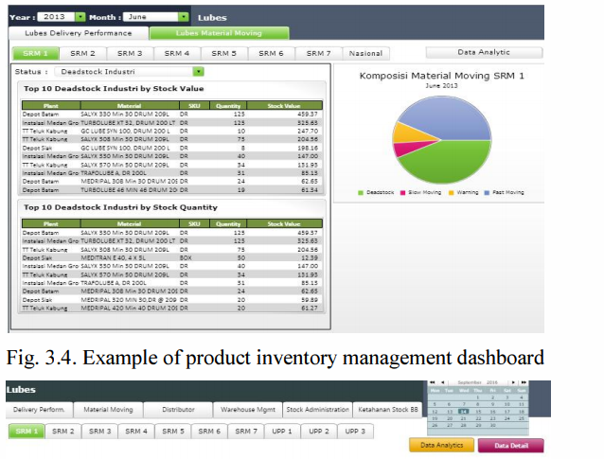
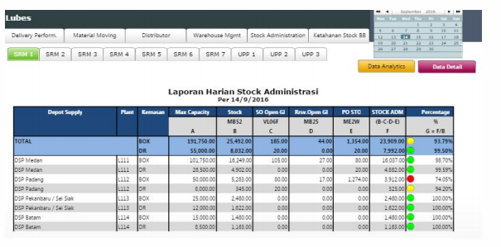

Slide 9
Role of data in Business decision making
Benefits:
Consolidation and protection of data. BI establishes a single point of access to data which previously spread in multiple systems. This enables Pertamina Lubricants to provide "one version of truth" which is critical in business decision making.
Optimize product distribution. BI provides lubes product movement information. By comparing product stock, Pertamina Lubricant management can analyze what the product type should be distributed in a specific region in a timely manner. It addresses "The Right Product at The Right Time at The Right Location" strategy.
Optimize warehouse management. BI serves real time stock information that includes current stock and available capacity of warehouse across depots. It helps the organization in making better production, distribution and sales planning, reducing the inventory cost, and optimizing warehouse management.
Challenges:
Challenges for data source quality: Manually entered at ERP level, Some transaction data is not timely input,
Challenges for personnel to handle the information and perform analysis. Human resources training, availability of reliable data and internet connection.

Slide 10
Results
By utilizing the comprehensive information provided in the management dashboard, PT Pertamina Lubricants is able to determine the optimum production and distribution planning to ensure the availability of products as enforced in the aspect of "The Right Product at The Right Time at the Right Location".
The dashboard also facilitates in establishing effective marketing strategies to boost the sales performance and achieve a sustainable competitive advantage. Furthermore, ad hoc reporting feature empowers end-users to drill-down and slice and dice data in a number of ways and create a new viewpoint of information to answer their business questions without having to request queries from IT Department.

